Slide 1

Trees Get Degrees: Decision Trees of Features for College Enrollment
By Weston Grewe and Angela Morrison

Slide 2


Motivation
Tailored to specific school communities
Better informing schools on how to prepare students to get into college
Interpretable and practical decision tree results

Slide 3

The Data
2017 Public School Data from Massachusetts
Remove schools that do not cater to any high school students
Remove features that are not standard among most if not all schools in the country
Convert data to binary variables for LP
Average Percentage of Students that Attended College after high school in Massachusetts
Used in determining is a school is “successful” in that they send a higher percentage of students to college after high school than the state as a whole

Slide 4

Quick Example
Group 1
Group 2
Name | Short | Average | Tall | Never Used a Steffen Bitmoji | Used 1 Steffen Bitmoji | Used More Than 1 Steffen Bitmoji | Eats Pizza With Pineapple
Alyssa | 1 | 0 | 0 | 0 | 0 | 1 | 1
Angela | 0 | 1 | 0 | 0 | 0 | 1 | -1
Collin | 0 | 0 | 1 | 0 | 1 | 0 | 1
Drew | 0 | 0 | 1 | 0 | 0 | 1 | 1
Michael | 0 | 0 | 1 | 0 | 1 | 0 | 1
Sandy | 0 | 0 | 1 | 1 | 0 | 0 | 1
Rebecca | 0 | 0 | 1 | 0 | 0 | 1 | 1
Weston | 1 | 0 | 0 | 0 | 1 | 0 | 1
Steffen | 0 | 0 | 1 | 1 | 0 | 0 | 1
Split on Average
Angela
The Rest of y’all

Slide 5

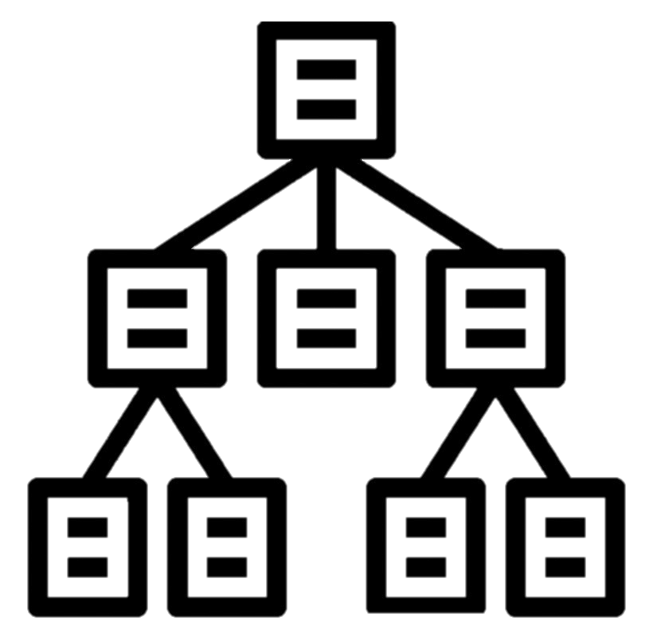
Model Set Up
Separate samples into “positive” and “negative” outcomes
Define tree structure
Determine ratio between total number of “positive” and “negative” outcomes to include factor in objective function
Determine groupings of features

Slide 6



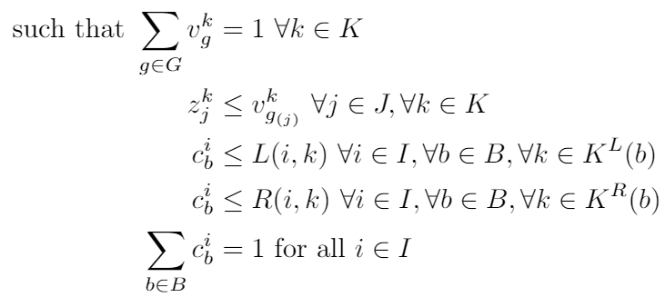



The Model
“negative” cases
“positive” cases
cases ratio
group used indicator
feature used indicator
nodes used to branch left
nodes used to branch right

Slide 7

Tree Structures Considered
1
2
3
4
5

Slide 8



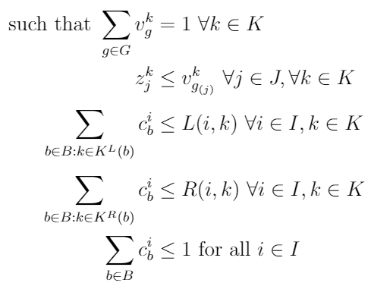

Numerical Feasibility
“negative” cases
“positive” cases
cases ratio
group used indicator
feature used indicator
nodes used to branch left
nodes used to branch right

Slide 9


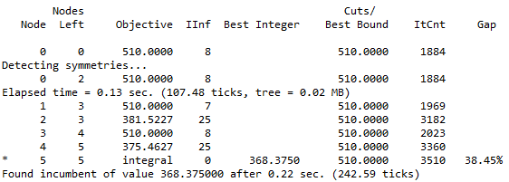
Branch and Bound Method
Settings in AMPL:
branch: controls whether you want to branch “up” or “down”
varsel : controls whether you branch on variable with the smallest or largest integer of feasibility or if you want to use strong branching.
Table of Results (for Tree 3)
Branch | Varsel | Number of Nodes | With Cutting Plane Constraints
Up | Variable with Smallest Integer Feasibility | 38,468 | 39,101
Up | Variable with Largest Integer Feasibility | 7,128 | 9,356
Up | Strong Branching | 3,194 | 1,681
Down | Variable with Smallest Integer Feasibility | 115,641 | 166,909
Down | Variable with Largest Integer Feasibility | 12,407 | 15,403
Down | Strong Branching | 778 | 845
Nodes Left in Search Set
Number of Integer Infeasible Variables in Solution
“Best” Achievable Objective Function
Node Number
Found Feasible Integer Solution
Sample AMPL Output

Slide 10


Results
First Language Not English 0-33%
1 AP Test Percent 0-33%
1 AP Test Percent 66-100%
1
2 AP Test 33-66%, 2 AP Test 66-100%
2
3
Total Enrollment 500-1000
Total Enrollment 1500-2000
2 AP Test 33-66%, 2 AP Test 66-100%
2 AP Test 33-66%, 2 AP Test 66-100%
Total Enrollment 500-1000
Total Enrollment 500-1000
Total Enrollment 2500-3000
4
5
1 AP Test 33-66%, 1 AP Test 66-100%
Avg Class Size 20-25, Avg Class Size 25-30, Avg Class Size 30-35
1 AP Test Percent 33-66%
1 AP Test Percent 66-100%
Avg Class Size 20-25, Avg Class Size 25-30, Avg Class Size 30-35
2 AP Test 66-100%
2 AP Test 66-100%
2 AP Test 33-66%, 2 AP Test 66-100%

Slide 11


Policy Implementations
Based on features used in data
Examples
Offer more AP classes/tests
Offer SAT Prep classes or more opportunities to take the SAT
Adjust class sizes or number of courses offered

Slide 12


References
Daziel, N. (2017, August 21). https://www.kaggle.com/ndalziel/massachusetts-public-schools-data.
Günlük, O., Kalagnanam, J., Li, M. et al. Optimal decision trees for categorical data via integer programming. J Glob Optim (2021). https://doi.org/10.1007/s10898-021-01009-y
ILOG AMPL CPLEX System Version 10.0 User’s Guide. ILOG (2006). https://www.ampl.com/BOOKLETS/amplcplex100userguide.pdf.
Progress reports: interpreting the node log. IBM. (n.d.). https://www.ibm.com/docs/en/icos/12.8.0.0?topic=mip-progress-reports-interpreting-node-log.

Slide 13



Questions, comments, concerns?

